Slide 1



Department of Computer Science and Engineering
SKIN DEEP ADVANCED MODEL
FOR ACCURATE SKIN DISEASE DIAGNOSIS
AKSHAYA V 211421104016
DEVI K 211421104053
HEMASREE R 211421104097
GUIDE NAME :
Mrs. S. SOPHANA JENNIFER ., M.E.,
ASSISTANT PROFESSOR
COORDINATOR NAME :
Dr. KAVITHA SUBRAMANI., M.E., Ph.D.,
PROFESSOR
1

Slide 2
Abstract
Skin diseases affect millions worldwide, presenting diverse challenges in diagnosis and treatment. This study proposes a deep learning approach using Convolutional Neural Networks implemented with TensorFlow for automated skin disease diagnosis. This model is trained on a comprehensive dataset comprising various skin conditions, aiming to achieve high accuracy in classification. Preprocessing techniques optimize image data, while Tensorflow from pre-trained models enhances efficiency. Evaluation metrics such as accuracy validate the model's performance. Results demonstrate promising outcomes in real-world scenarios, suggesting potential applications in telemedicine and dermatological practice. This research contributes to advancing AI-driven healthcare solutions, addressing the diagnostic complexities of skin diseases through innovative technology.
2

Slide 3
Introduction
Skin disease is rising worldwide, with 12,500 deaths and 104,000 new cases in the US in 2023. Excessive UV exposure, tanning beds, infections, and genetics are key causes. Basal cell carcinoma is rarely fatal, while squamous cell carcinoma can be deadly if untreated. Melanoma, the most dangerous type, spreads rapidly and originates in melanocytes. UV exposure significantly increases risk, especially among women under 40. Early detection is critical. Dermatologists use dermoscopy and screening techniques like the ABCD rule, but visual diagnosis remains challenging. While dermoscopy improves accuracy, it requires specialists and time. A computerized system is essential for efficient skin disease detection.Advancements in artificial intelligence and deep learning have shown promise in automating skin disease diagnosis. AI-powered image analysis can enhance accuracy, reduce diagnostic time, and assist dermatologists in detecting melanoma at an early stage. Implementing these technologies could lead to better patient outcomes and survival rates.
3
Notes:
3

Slide 4
Objective of the Project
The objective of the project is to develop an efficient and accurate AI-driven diagnostic system for skin disease classification. This system leverages deep learning models, particularly a 1-D multiheaded convolutional neural network (CNN), to improve early detection and classification of skin disease. By integrating spatial and spectral domain data, the proposed model enhances diagnostic accuracy, reduces reliance on subjective human judgment, and speeds up the screening process. The ultimate goal is to support dermatologists in making more precise diagnoses and improve patient outcomes, particularly for high-risk conditions like melanoma.
4

Slide 5
Literature Survey
S No | Year of Publication | Author Details | Journel Deatils | Approach | Outcome
1 | 2024 | Anurodh Kumar, Amit Vishwakarma, Varun Bajaj | Title : Novel Mixed Domain Hand-Crafted Features for Skin Disease Recognition Using Multiheaded CNN . Volume and Issue: Vol. 4, No. 5 Pages: 5526–5530 Date: May 2023 ISSN: 2582-7421 Journal Homepage: www.ijrpr.com | 1.Fine-tuned the model using parameter-efficient techniques (P-Tuning v2) for generating context-specific medical explanations. 2. Developed a web-based user interface for easy interaction and diagnosis. 3. Integrated AI models to deliver image analysis results and text-based feedback in a conversational format. | Overall accuracy: 85.05% Validation accuracy: 80.36%
2 | 2023 | Adarsh Jadhav, Shivani Hardade, Vaishnavi Phadtare, Adesh Mhetre, Ms. Rutuja Tikait | Title: Skin Disease Prediction Using Deep Learning Volume and Issue: Vol. 4, No. 5 Pages: 5526–5530 Date: May 2023 ISSN: 2582-7421 Journal Homepage: www.ijrpr.com | 1. Standardized images to 224x224 pixels and split into training and validation sets. 2.Optimized the model, assessed performance using accuracy, precision, recall, and F1 score. | Overall accuracy: 87.05% Validation accuracy: 81.36%
5
Notes:
5

Slide 6
Literature Survey
S NO | Year of Publication | Author Details | Journel Details | Approach | Outcome
3 | 2023 | T. Swapna, D.A. Vineela, M. Navyasree, N. Sushmtha, P. Bhavana | Title: Detection and Classification of Skin diseases using Deep Learning Volume: XIII Issue: VIII Date: August 2021 ISSN: 0886-9367 Page: 1096–1101 | 1. Framework: Utilized CNN 2. Dataset: Consists of images representing seven skin diseases (e.g., melanoma, nevus, seborrheic keratosis). 3. Methodology: A web application was designed where users can upload images of affected skin areas for disease classification and treatment suggestions. | Overall accuracy: 94.05% Validation accuracy: 89.36%
4 | 2023 | Xia, Deneng | Title:Skin disease diagnosis using deep neural network and large language model. Volume and Issue: Vol. 4, No. 5 Pages: 5526–5530 ISSN:2582-7421 Journal | 1.Fine-tuned the model using parameter-efficient techniques (P-Tuning v2) for generating context-specific medical explanations. 2. Developed a web-based user interface for easy interaction and diagnosis. | Overall accuracy: 84.05% Validation accuracy: 81.36%
6
Notes:
6

Slide 7
Literature Survey
S NO | Year of Publication | Author Details | Journel Details | Approach | Outcome
5 | 2023 | Manu Goyal1 , Thomas Knackstedt2 , Shaofeng Yan3 | Title : Artificial Intelligence-Based Image Classification for Diagnosis of Skin Cancer: Challenges and Opportunitie | This review explores the development of AI-enabled computer-aided diagnostic systems for skin cancer detection. It highlights the increasing need for AI assistance due to rising skin cancer cases, low awareness, and limited clinical expertise. | Overall accuracy: 82.05% Validation accuracy: 86.76%
6 | 2020 | Noortaz Rezaoana, Mohammad Shahadat Hossain, Karl Andersson | Title : Detection and Classification of Skin Cancer by Using a Parallel CNN Mode | This paper proposes an automated technique for skin cancer classification using deep learning and image processing. It focuses on early detection to improve treatment outcomes by leveraging Convolutional Neural Networks (CNNs) to classify nine types of skin cancer, including melanoma, basal cell carcinoma, and squamous cell carcinoma. | Overall accuracy: 90.09% Validation accuracy: 86.63%
6
Notes:
6

Slide 8
Literature Survey
S NO | Year of Publication | Author Details | Journel Details | Approach | Outcome
7 | 2023 | Xiaoke Ma , Wei Zhao, and Wenming Wu | Title : Layer-Specific Modules Detection in Cancer Multi-Layer Networks | This paper introduces LSNMF, a novel graph clustering algorithm for multi-layer networks using Nonnegative Matrix Factorization (NMF). It extracts and decomposes vertex features into common and layer-specific components, ensuring better structural characterization. | Overall accuracy: 88.65% Validation accuracy: 89.45%
8 | 2020 | Marzuraikah Mohd Stofa, Mohd Asyraf Zulkifley, Muhammad | Title : Skin Lesions Classification and : A Review | This paper reviews deep learning-based approaches for automated skin disease diagnosis, addressing challenges in lesion complexity. It analyzes classification techniques, lesion detection methods, and evaluates 12 CNN models using accuracy, specificity, sensitivity, and AUC. | Overall accuracy: 81.25% Validation accuracy: 88.87%
6
Notes:
6

Slide 9
Problem Statement
Skin diseases affect millions worldwide, with diagnosis often hindered by moderate accuracy, subjectivity, and inefficiency. Current methods rely heavily on spatial data and dermatologist expertise, overlooking spectral information and lacking adaptability. An advanced system integrating spatial and spectral features through deep learning techniques like CNNs offers a solution. This system enhances diagnostic precision, efficiency, and accessibility, transforming early detection and treatment of skin diseases.
7

Slide 10
Proposed System
The Proposed system aims to revolutionize skin disease diagnosis by leveraging advanced deep learning techniques. Using Convolutional Neural Networks implemented with TensorFlow, our system will analyse skin images to accurately classify and diagnose various dermatological conditions. The process begins with users uploading skin images through a Django-based interface, ensuring ease of access and user-friendly interaction. Once uploaded, the images undergo pre-processing to enhance quality and standardize format, crucial for effective analysis. This model, trained on a diverse dataset of annotated skin images encompassing various diseases and conditions, will then perform feature extraction and classification. TensorFlow's framework ensures efficient model training and deployment, optimizing performance and accuracy. Upon classification, the system will provide detailed diagnostic reports, including probable conditions, confidence levels, and recommended actions such as further consultation or treatment. User feedback and iterative model improvement are integrated to enhance diagnostic precision over time.
8

Slide 11
Software / Hardware used
SOFTWARE:
Operating System : Windows / Linux
Simulation Tool : Anaconda with Jupyter Notebook
Language : Python
HARDWARE:
Processor : Intel i3
Hard disk : minimum 400 GB
RAM : minimum 4 GB
9

Slide 12
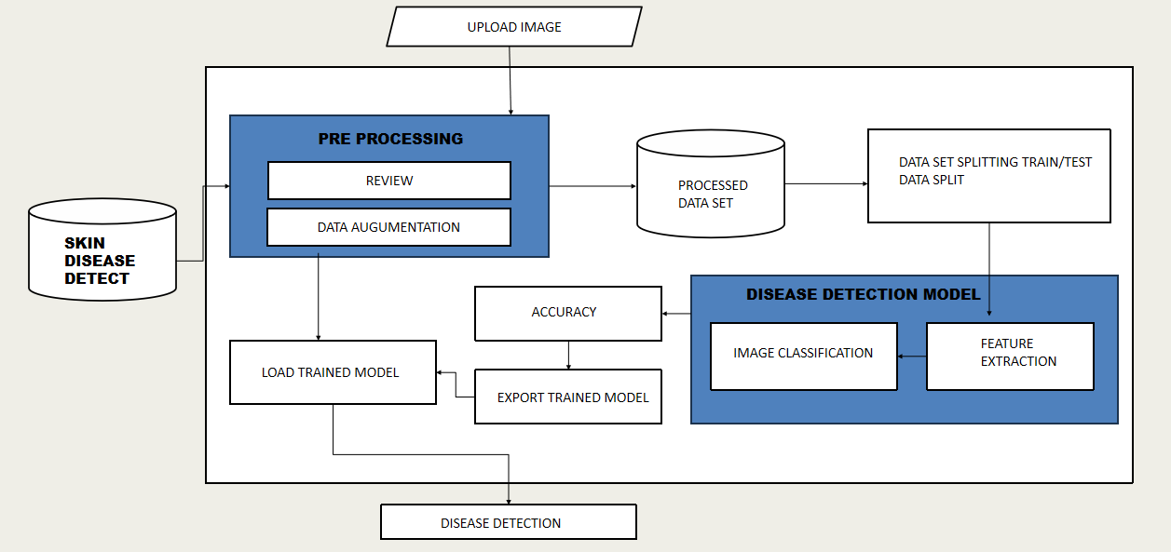
Architecture Diagram
10

Slide 13
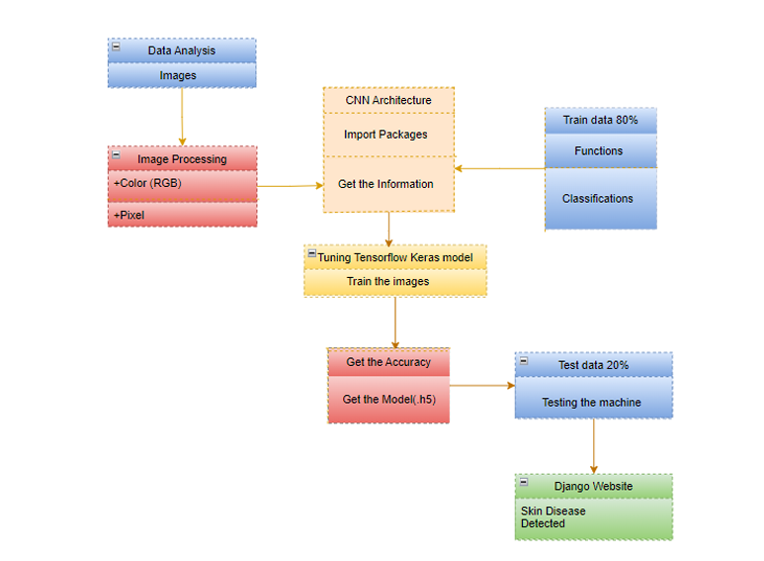
Class Diagram
17-03-2025
Title of the Project
11

Slide 14
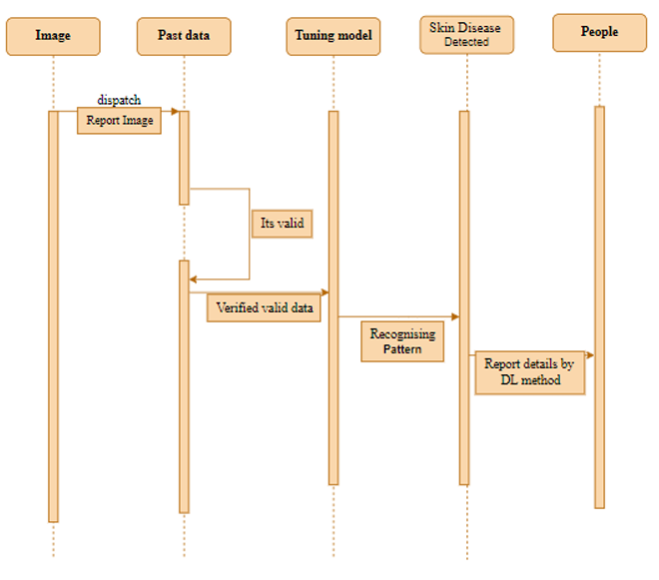
Sequence Diagram
12

Slide 15
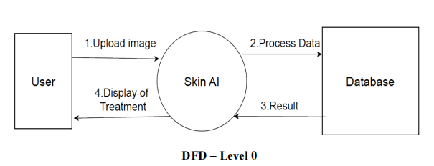
Data Flow Diagram
13

Slide 16
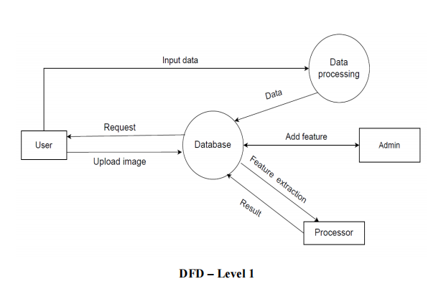
Data Flow Diagram
13

Slide 17
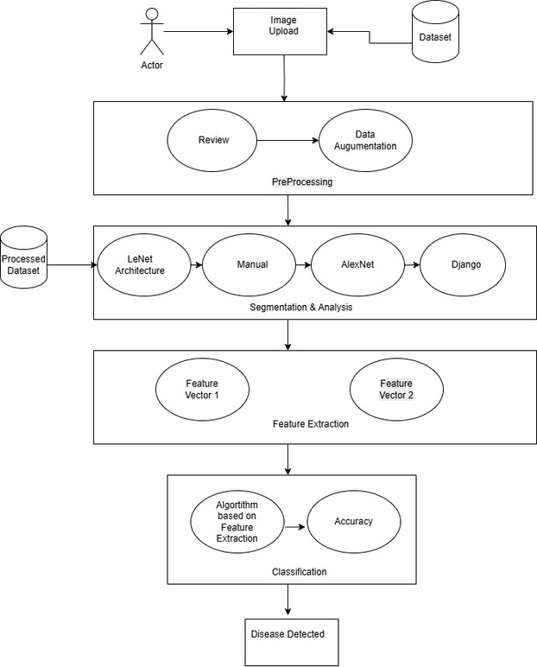
Data Flow Diagram
13
DFD - Level 2

Slide 18
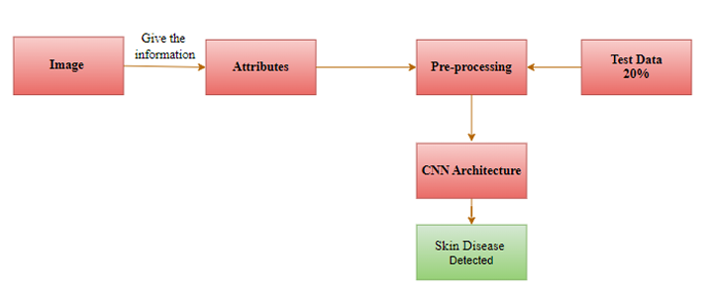
Collaboration Diagram
14

Slide 19
Module Description
Importing Data & Preprocessing
In this process, skin images are prepared for analysis using Keras' image data generator, which applies several preprocessing techniques:
Resizing: Adjusting images to a uniform size ensures consistency across the dataset, making them compatible with the input requirements of the model.
Rescaling: Normalizing pixel values (e.g., scaling from 0-255 to 0-1) enhances numerical stability and speeds up the training process.
Zooming: Randomly zooming into images helps the model learn to recognize features at different scales, improving generalization.
Flipping: Horizontally or vertically flipping images increases dataset variability, reducing overfitting by simulating real-world variations.
These steps are critical for improving model performance and robustness.
15

Slide 20
Module Description
CNN Model for Disease Detection
A Convolutional Neural Network (CNN) model for disease detection leverages structured inputs to enhance the accuracy and precision of diagnosing skin conditions. Dermatologists traditionally rely on key visual features, including asymmetry, border characteristics, and color patterns, to manually classify skin diseases. By automating this process, AI models like CNNs not only replicate these diagnostic techniques but also improve efficiency and overall diagnostic accuracy, providing a powerful tool for clinical decision-making.
Asymmetry
Border features
Color patterns
AI models improve diagnostic accuracy and efficiency by automating this process.
16

Slide 21
Module Description
LeNet-5 CNN Architecture with Modifications
The LeNet-5 CNN architecture with modifications is designed to enhance performance in specific tasks. It incorporates essential layers such as convolutional, pooling, and encoder-decoder layers to extract and process features effectively. The model is fine-tuned using various techniques:
Activation Functions: Functions like ReLU help introduce non-linearity, improving the model's learning capabilities.
Loss Functions: These guide the optimization process by minimizing errors during training.
Optimizers (e.g., Adam, SGD): Algorithms used to adjust weights and biases for faster and more efficient convergence.
The model's performance is assessed using metrics like IoU (Intersection over Union) and the Dice coefficient, which measure the overlap accuracy between predicted and actual outputs, ensuring reliable and robust results.
17

Slide 22
Module Description
Implementation with Django
The trained model is deployed using the Django framework, enabling real-time skin disease detection. Users can upload images of skin conditions, which the system processes through the trained model to deliver instant diagnostic results.
The Django framework serves as the backbone for deploying the trained skin disease detection model as a web application. Here's how it works:
Image Upload Feature: Django provides an intuitive interface where users can upload images of skin conditions securely.
Backend Processing: Once the image is uploaded, it is passed to the trained model integrated into the Django backend. The model analyzes the image, extracting features and classifying it based on the trained parameters.
Real-Time Predictions: The application delivers diagnostic results in real time, offering users immediate feedback on potential skin conditions.
Scalability: Django's robust architecture ensures the system is scalable, allowing it to handle multiple user requests simultaneously.
18

Slide 23
Result
The proposed one-dimensional (1-D) multiheaded convolutional neural network
(CNN) is implemented in Python and run on a 3.20 GHz central processing unit with
256-gigabyte solid-state storage. Performance of the model is evaluated with
different metrics including accuracy, F1 score, precision, specificity, sensitivity, and
area under the curve (AUC).Two widely used datasets, HAM10000 and Dermnet,
are employed for multiclass skin lesion classification.
Data augmentation and class balancing strategies are applied for improving
model performance. Both of the datasets have 4,375 dermoscopy images that are
divided into training, testing, and validation subsets. That is, 80% of the images are
kept for training, 12% for testing, and 8% for validation.The model takes hand?
crafted features from spatial, spectral, and cepstrum spaces as input. Performance of
the proposed method is assessed using the mean and the standard deviation of the
evaluation metrics as well as the 95% confidence interval for statistical reliability
18

Slide 24

Screenshots
19

Slide 25
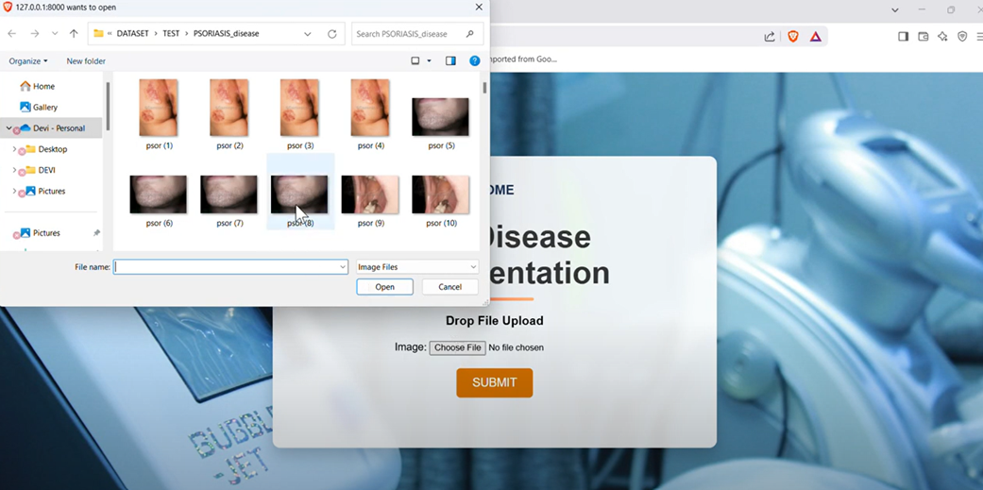
Screenshots
20

Slide 26
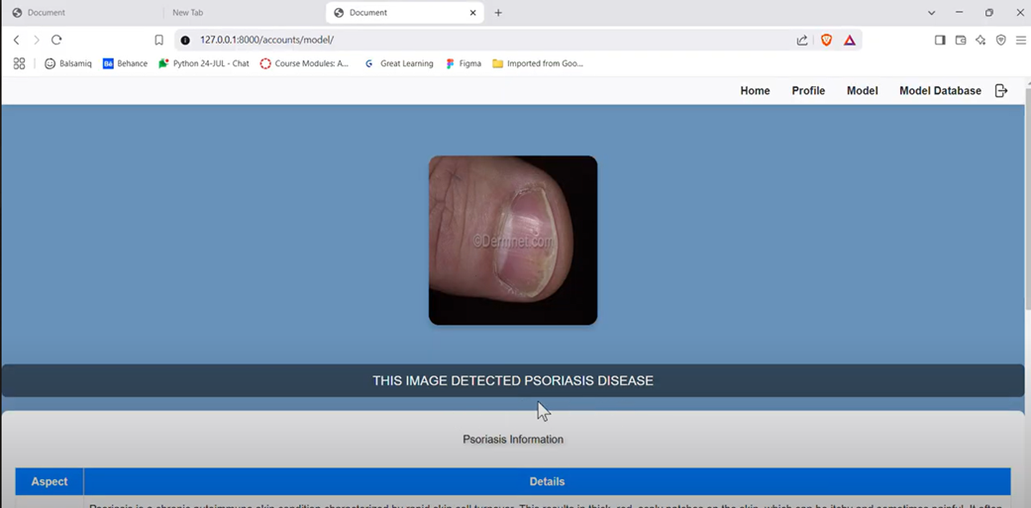
Screenshots
17-03-2025
Title of the Project
21

Slide 27
Conclusion
This study highlights how dermatologists benefit from automated skin lesion classification for decision-making. The authors proposed a novel method by combining image, spectrogram, and cepstrum domain features to create enhanced hand-crafted features. These features captured both spectral and spatial information, crucial for analyzing challenging dermoscopy images. A 1-D multiheaded CNN model was then applied to classify skin lesions using the concatenated features as input. The results demonstrated improved performance metrics, including Accuracy, Specificity, Precision, Sensitivity, AUC, and F1 scores, surpassing other state-of-the-art methods. Notably, the approach achieved 88.57% accuracy on the Dermnet dataset and 89.71% on HAM10000. Looking ahead, the methodology could be extended to analyze various biological signals and medical imaging datasets, advancing healthcare applications beyond skin lesions.
22

Slide 28
Future Enhancement
Enhance Data Diversity: Expanding datasets to include a broader range of skin conditions and demographics aims to ensure the model is exposed to diverse examples. This helps improve the model's robustness, making it more capable of generalizing across various real-world scenarios. Addressing class imbalances further ensures that the model doesn't favor one category over another, enhancing fairness and reliability.
Develop Interpretability Methods: Creating techniques to make Convolutional Neural Networks (CNNs) more interpretable allows clinicians to understand how decisions are being made by the model. This transparency builds trust and ensures that the models can be used confidently in clinical practice, enabling effective integration into healthcare workflows.
23

Slide 29
References
[1].R. L. Siegel, K. D. Miller, N. S. Wagle, and A. Jemal, “Cancer statistics, 2023,” CA, Cancer J. Clinicians, vol. 73, no. 1, pp. 17 48, Jan. 2023.
[2] A. Kumar, A. Vishwakarma, and V. Bajaj, “CRCCN-Net: Automated framework for classification of colorectal tissue using histopathological images,” Biomed. Signal Process. Control, vol. 79, Jan. 2023, Art. no. 104172.
[3] A. Kamble, P. H. Ghare, and V. Kumar, “Deep-learning-based BCI for automatic imagined speech recognition using SPWVD,” IEEE Trans. Instrum. Meas., vol. 72, pp. 1–10, 2023
[4] M. Heenaye-Mamode Khan et al., “Multi-class skin problem classification using deep generative adversarial network (DGAN),” Comput. Intell. Neurosci., vol. 2022, pp. 1–13, Mar. 2022.
[5] A. K. Sharma et al., “Dermatologist-level classification of skin cancer using cascaded ensembling of convolutional neural network and handcrafted features based deep neural network,” IEEE Access, vol. 10, pp. 17920–17932, 2022.
24

Slide 30
References
[6] K. Ali, Z. A. Shaikh, A. A. Khan, and A. A. Laghari, “Multiclass skin cancer classification using EfficientNets—A first step towards preventing skin cancer,” Neurosci. Informat., vol. 2, no. 4, Dec. 2022, Art. no. 100034.
[7] H. W. Loh, C. P. Ooi, E. Aydemir, T. Tuncer, S. Dogan, and U. R. Acharya, “Decision support system for major depression detection using spectrogram and convolution neural network with EEG signals,” Expert Syst., vol. 39, no. 3, Mar. 2022, Art. no. e12773.
[8] K. Gupta, V. Bajaj, and I. A. Ansari, “OSACN-Net: Automated classification of sleep apnea using deep learning model and smoothed Gabor spectrograms of ECG signal,” IEEE Trans. Instrum. Meas., vol. 71, pp. 1– 9, 2022.
[9] Y. Qi et al.., “Highly accurate diagnosis of lung adenocarcinoma and squamous cell carcinoma tissues by deep learning,” Spectrochimica Acta A, Mol. Biomolecular Spectrosc., vol. 265, Jan. 2022, Art. no. 120400.
[10] S. Ghosh, S. Das, and R. Mallipeddi, “A deep learning framework integrating the spectral and spatial features for image-assisted medical diagnostics,” IEEE Access, vol. 9, pp. 163686–163696, 2021.
25

Slide 31
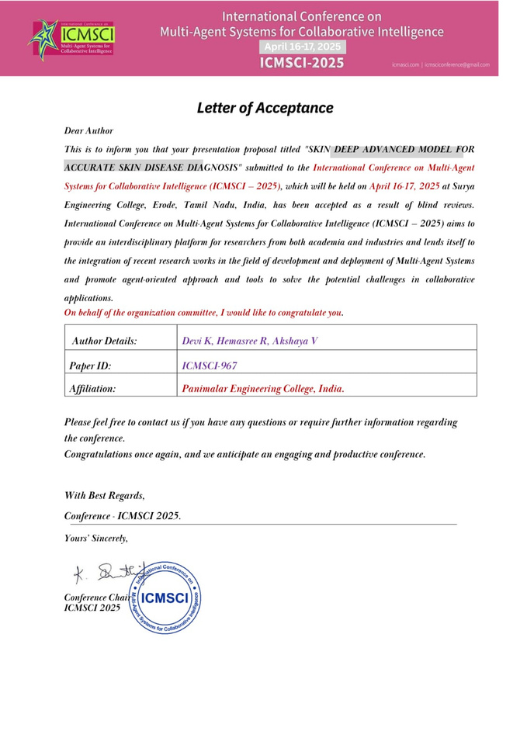
Paper Publication
26

